Slide 1

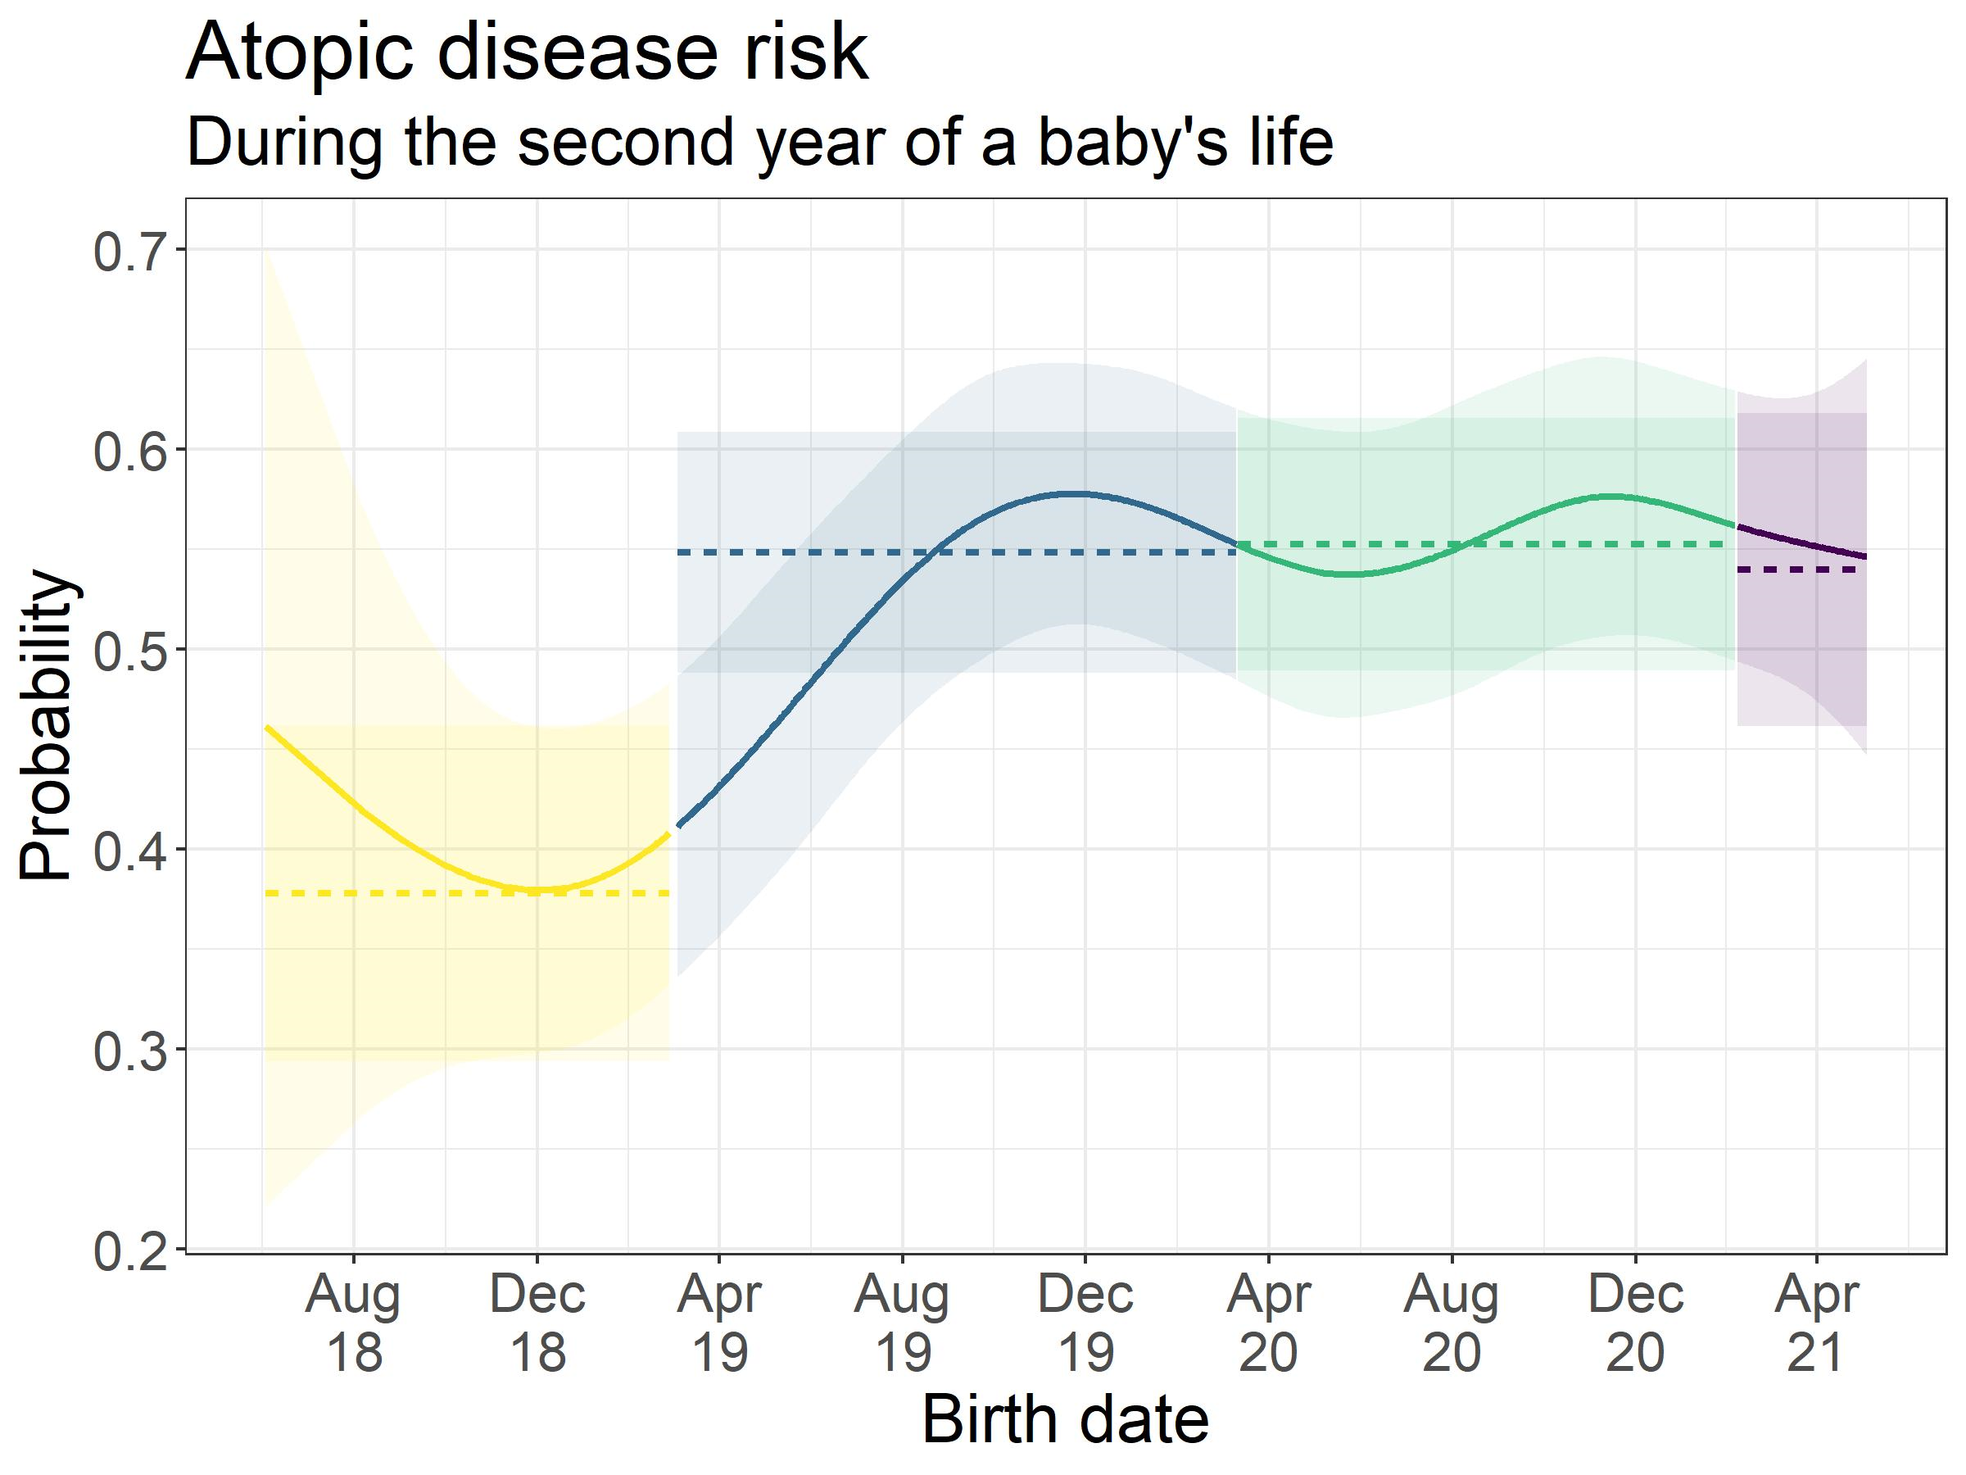
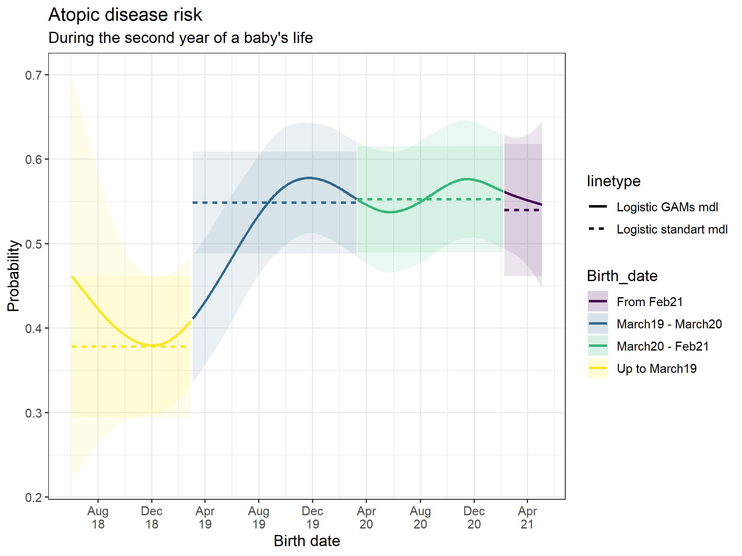
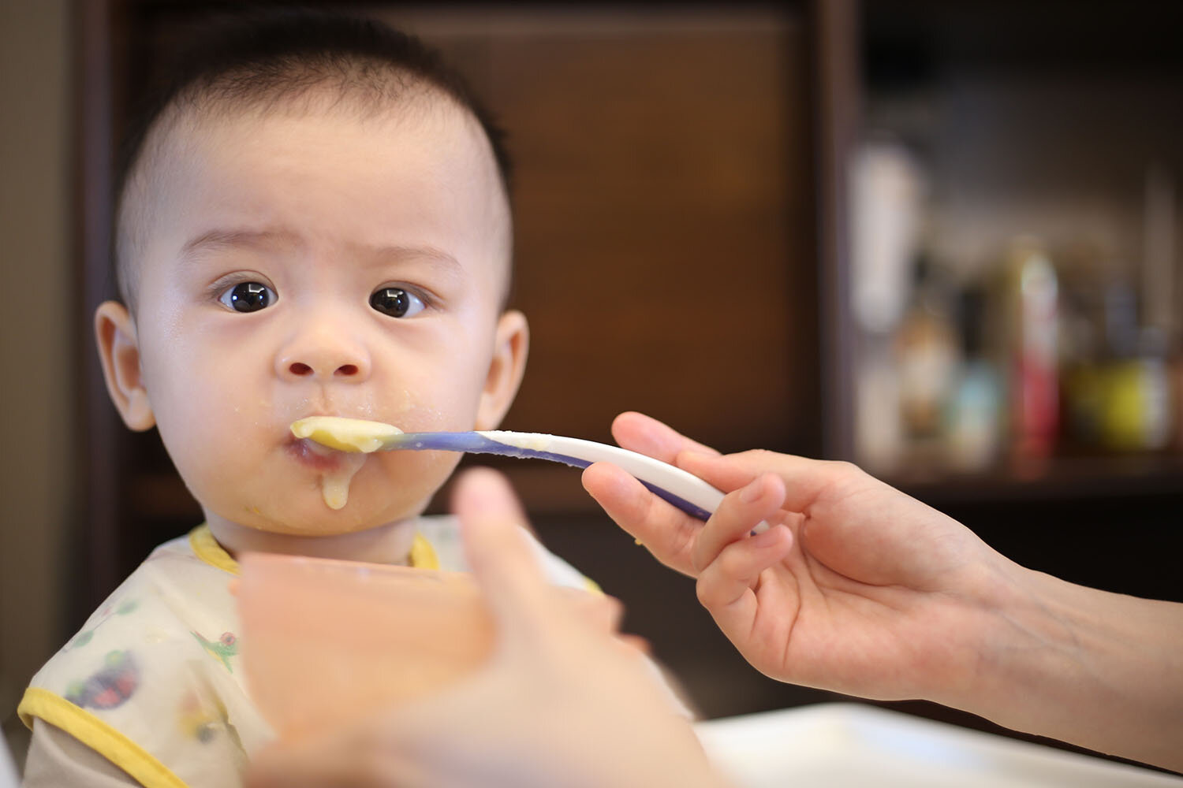
The Golden opportunity Examining the effect of hygiene theory on atopic diseases in newborns
Shahar Shalom, Eden Anavim, Merav Pervil | Faculty Instructor: Prof. Micha Mandel
Counselee: Prof. Idit Lachover-Roth, Allergy & Clinical Immunology Unit, Meir Medical Center, Israel
Background
COVID-19 had increased hygiene awareness. Following the pandemic, several studies led to the following findings: Social distance reduced the prevalence of pediatric non-COVID infections. Infants born in the first peek had significantly less respiratory morbidity in first year. Increased pediatric viral infections following the 1st and 2nd lockdowns.
Results
Results of the Second-year - Logistic standard regression Vs. Logistic GAMs model : Probability of a typical baby getting an Atopic disease (2nd Y) depending on birth date:
Variable | Logistic standard model |  |  |  | Logistic GAM's model
 | Estimate | Std | P val | Odds Ratio | Estimate | Std | P val
Intercept | -1.71 | 0.56 | 0.00 |  | -1.03 | 0.56 | 0.07
SES Groups 6-8 | 0.32 | 0.16 | 0.05 |  | 0.32 | 0.16 | 0.05
SES Groups 9-10 | 0.10 | 0.19 | 0.62 |  | 0.10 | 0.19 | 0.62
Gender - Female | -0.17 | 0.11 | 0.11 |  | -0.17 | 0.11 | 0.10
Number of siblings 1-2 | -0.11 | 0.13 | 0.36 |  | -0.12 | 0.13 | 0.35
Number of siblings 3+ | -0.44 | 0.21 | 0.04 |  | -0.46 | 0.21 | 0.03
Mode of delivery - Natural | 0.12 | 0.18 | 0.49 |  | 0.14 | 0.18 | 0.45
Type of pregnancy - Spontaneous | 0.09 | 0.20 | 0.63 |  | 0.11 | 0.20 | 0.59
Feeding type - Breastfeeding + CMF | 0.05 | 0.12 | 0.70 |  | 0.03 | 0.12 | 0.80
Feeding type - CMF | -0.02 | 0.16 | 0.89 |  | -0.03 | 0.16 | 0.84
Father with atopic disease | 0.09 | 0.16 | 0.58 |  | 0.10 | 0.16 | 0.53
Mother with atopic disease | 0.14 | 0.14 | 0.31 |  | 0.14 | 0.14 | 0.32
Mother year of birth | -0.02 | 0.01 | 0.08 |  | -0.03 | 0.01 | 0.06
Mother education - Post graduate | 0.00 | 0.23 | 0.99 |  | 0.01 | 0.23 | 0.95
Mother education - Academic | 0.11 | 0.17 | 0.51 |  | 0.12 | 0.17 | 0.50
Vaccine 1st year | 0.50 | 0.28 | 0.07 |  | 0.51 | 0.28 | 0.07
Nursing at 1st year - Private nanny | -0.38 | 0.23 | 0.09 |  | -0.37 | 0.23 | 0.11
Nursing at 1st year - Day care | -0.08 | 0.12 | 0.53 |  | -0.09 | 0.12 | 0.47
Atopic disease 1st year | 0.84 | 0.11 | 0.00 |  | 0.85 | 0.11 | 0.00
Antibiotic treatment 1st year | 0.76 | 0.12 | 0.00 |  | 0.75 | 0.12 | 0.00
Birth date - March19 to March20 | 0.69 | 0.20 | 0.00 | 2.00 |  |  | 0.00
Birth date - March20 to Feb21 | 0.71 | 0.19 | 0.00 | 2.03
Birth date - From Feb21 | 0.66 | 0.23 | 0.00 | 1.93
Research Objective
It was therefore a golden opportunity to assess the influence of a highly hygienic environment on atopic comorbidities in infants.
Data and its collection
Data was collected starting from November 2018. Experiment participants: Hebrew speaking parents from all sectors, close to due date with normal birth weight and no defects. At predetermined intervals, parents were sent questionnaires to complete Characteristics of the babies, their families, and their environment were collected. Development of atopic diseases among babies was examined during experiment. The babies were divided into 4 groups according to the date of birth and main landmarks during the pandemic
Group | Birth | 1Y Sickness percent | 2Y Sickness percent
1 | Up to March19 | 520. | 0.36
2 | March19 to March 20 | 0.50 | 0.43
3 | March20 to Feb21 | 0.55 | 0.49
4 | From Feb21 | 0.7 | 0.51
Experimental Design
Standard logistic regression Model was used to test the effect of explanatory characteristics on the probability of having an atopic disease using birth date group as the categorical variable. Logistic regression using Generalized Additive Model: Logistic GAM’s model provides us with an alternative to dividing the birth date into groups, we made the birth date variable continuous instead of categorical (every day preform as a category). We used a non-linear combination of variables, which create a smooth function. By connecting these smooth functions, we examined how the probability of a baby getting an atopic disease changes.
Conclusions
In the logistic model, birth date variables are significant. The smoothed estimator in Logistic GAM’s model significant as well. For babies born during the Covid19 period, the risk of getting an atopic disease in the second year of life was increased.

